Slide 1
Genesis
By Bradley Lamitie
11 / 15 / 2017

Slide 2
Game Design
5 components of Game Design
Play rules and mechanics
Level design
Interaction design
Audio-Visual Design
Story

Slide 3
Play rules and mechanics
Currently the player can use move, spells, potions, and attack.
The player takes damage every time an enemy hits them.
The player loses if their health bar drops below 0.
Enemies currently cannot do much besides move and chase the player.
NPCs can give quests to the player.
For now, the player wins if they unlock the clocktower door.

Slide 4
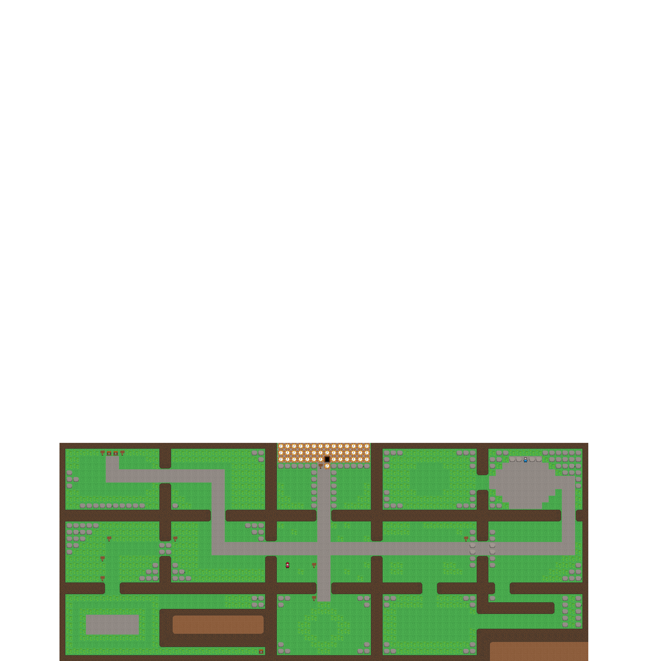
Level Design
Currently there is only one level.
This one level contains 15 rooms.
The Rocks cannot be removed until the player has gotten the explosion spell.

Slide 5
Interaction design
The player can interact with the game as follows:
W/S - Cycle Spell Forward/Backward Q - Use Spell
A/D - Cycle Potion Forward/Backward E - Use Spell
Space Bar - Interact Right Shift - Attack
Arrow Keys - Move H - Show controls (5 seconds)
The feedback system shows health, mana, currently equipped spells and potions, and money

Slide 6

Audio-Visual design
Visual:
I used Pixil Art to create my sprites.
I used Tiled to construct the world
I used a font called Silk Wonderland by jelloween
Audio:
I used a song called “The White” by RoleMusic for the overworld theme

Slide 7
Story
As of now, I don't have a firm storyline worked out, but:
You play as an angel cast onto earth after having your wings stripped from you.
Your goal is to defeat all 7 virtues on Earth to redeem yourself and earn your place back in heaven.
However, the boss battle against the first virtue(Patience) isn’t finished yet.

Slide 8
Glitches
Known Glitches:
- Dialog runs through too quickly
- Player attack sprite is too short
- Sometimes enemies disappear into walls or move unnaturally fast
- Player Sprite warps when attacking
- Dialog doesn’t disappear for awhile.

Slide 9
TODOs:
- Finish building the world's second level. - Add Item Drops
- Animate the characters as they move throughout the world. - Add quest feedback
- Replace all clocktower_door sprites with new sprites. - Add Screen animations
- Add cheat codes for quick demonstrations. - Game Balancing
- Add sounds to go with visual cues

